Slide 1
Module 2: Moving From One View to Another
SER 423

Slide 2
Overview

Slide 3
The Need to Switch
As discussed, an app consists of Views
Simple apps can all be fit on one View
However, the need quickly arises to have multiple Views if you have an app with any level of complexity
We can switch between Views by making use of the app lifecycle methods we discussed last time
React provides multiple ways of switching between Views, which provides an abstraction layer on top of these methods
We will eventually work directly with the lifecycle methods, but for now we can use these abstractions to get started

Slide 4
Tab Navigator

Slide 5
Introduction to the Tab Navigator
TabNavigator is an API within react-navigation that you can import into your file
This allows you to create a series of tabs that the User can switch between
These are essentially a series of buttons that you can respond to
TabBarBottom makes this series of tabs appear along the bottom of the screen
  There are others you can import instead if you want your bar of tabs somewhere else
Each View you want to display will need to be defined
  This is usually done in a separate file and imported in
These Views will extend React.component as usual and at least have a render function that returns a View as normal

Slide 6
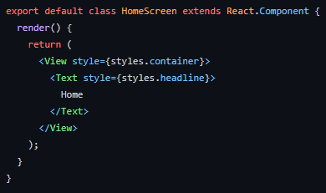
Example Simple View for Display

Slide 7
Setting Up Our Tab Navigation
In order to set the navigation up, we first need to define the different Views that can be shown
We do this by making a RouteConfig object within our TabNavigator
This is a map, where each key is some name you’ve defined for each View
Under each key you store a single screen value, which is the View you’ve imported
We then need to define the navigationOptions property of the TabNavigatorConfig object
This should be dynamic to handle each different View
This all probably sounds like a lot, but once we take a look at it all of these pieces should fall into place easier

Slide 8
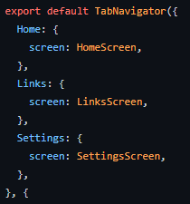
The RouteConfig Object

Slide 9
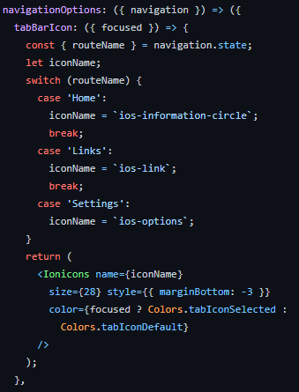
The NavigationOptions Property

Slide 10
Continuing This Idea
We can then obviously continue this to add as many Views as we want
This will eventually lead to running out of room
One of the things we will look at next time is buttons and lists
Most apps don’t have a giant set of tabs
Buttons can be placed anywhere in the View and if you really need a long list of options, that’s what the lists are for
This however does provide some very straightforward navigation and can easily be used for many of the sorts of apps we’ll be building in this class

Slide 11
End of Moving Between Views
That’s all for Module 2

